Slide 1


Learning a State Transition Model of an
Underactuated Adaptive Hand
Avishai Sintov, Andrew S. Morgan, Andrew Kimmel,
Aaron M. Dollar, Kostas E. Bekris and Abdeslam Boularias

Slide 2
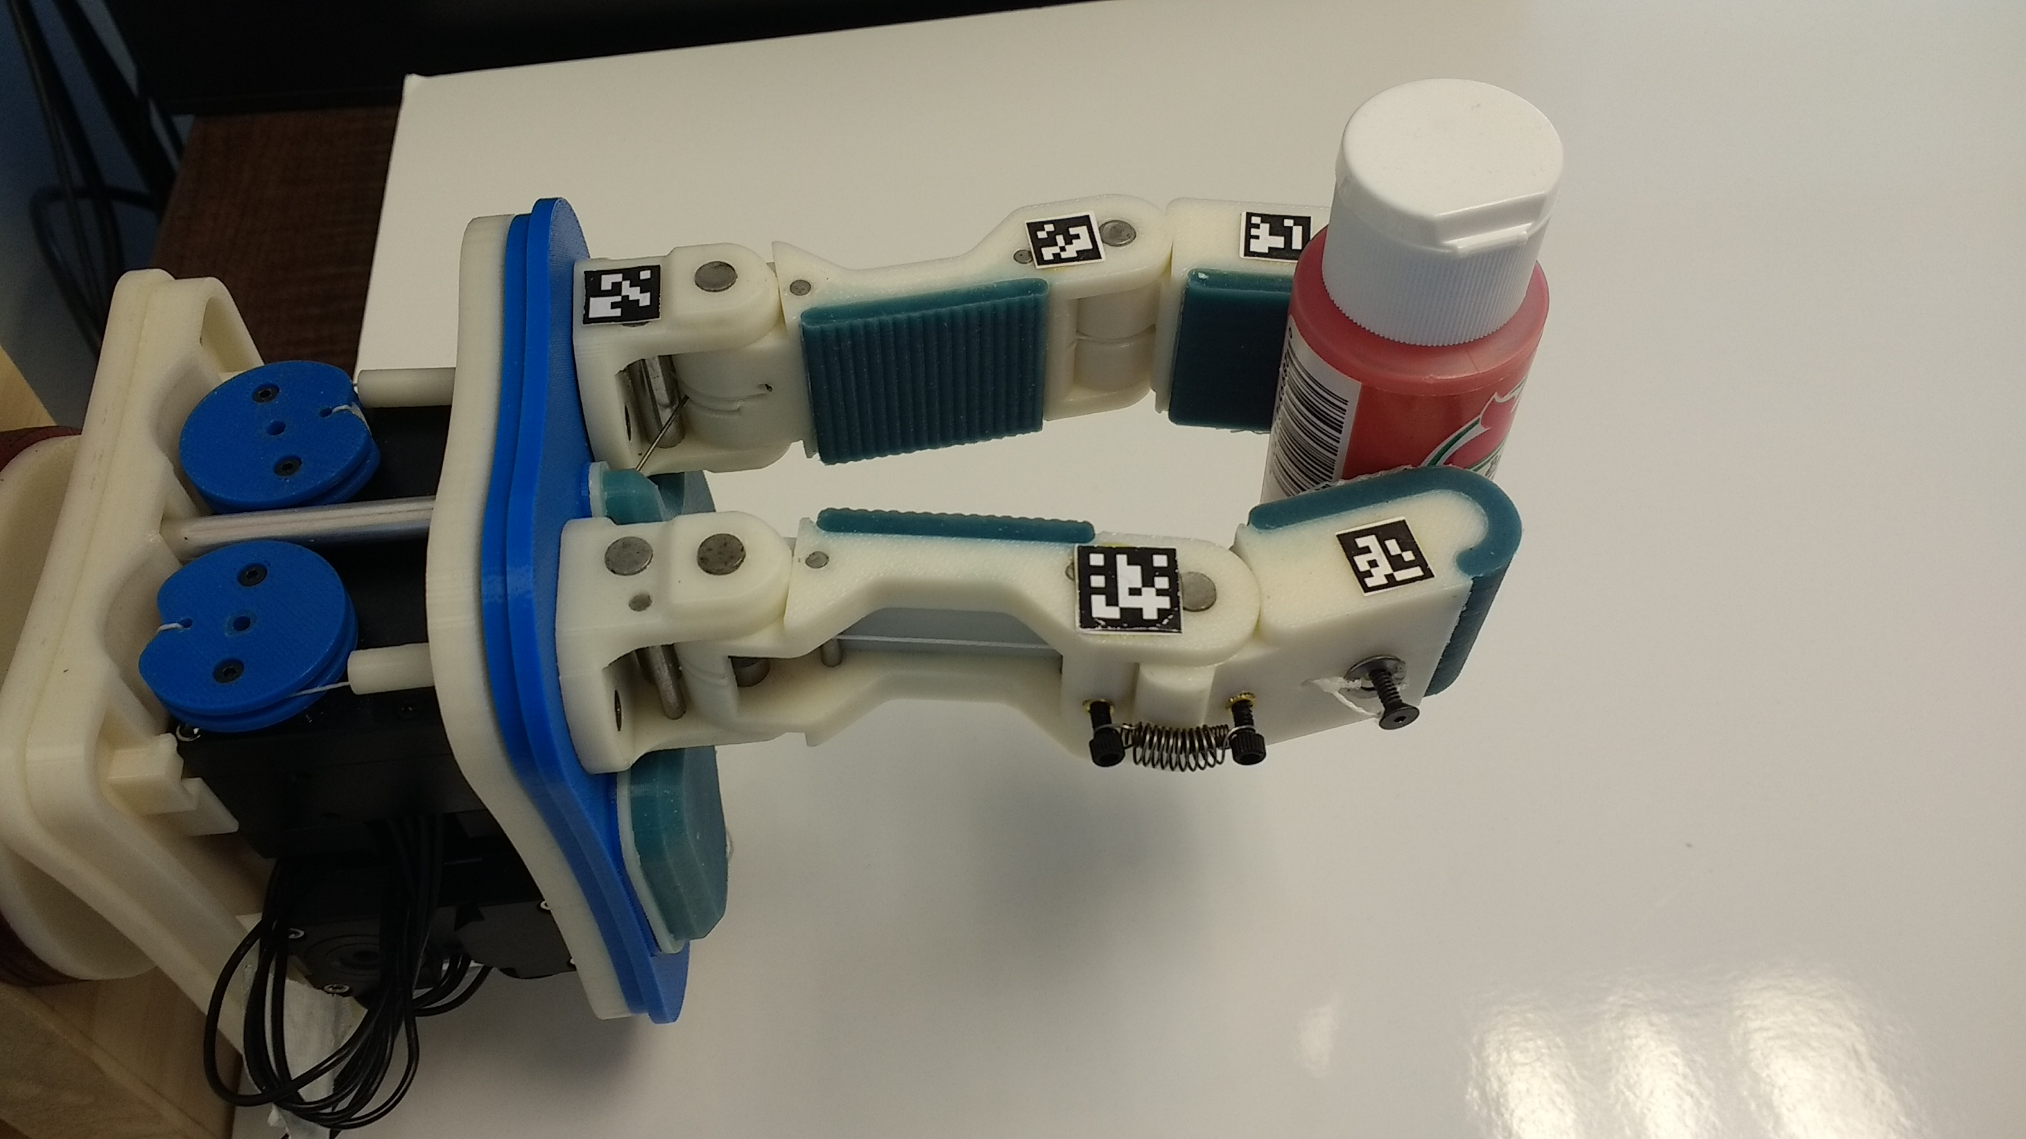
Adaptive hands
Underactuated adaptive hands with compliant fingers are appealing due to their ability to passively adapt to objects of uncertain size and shape.
Therefore, they can provide a stable and robust grasp without tactile sensing or prior planning, and with open-loop control.

Slide 3
Adaptive hands
Good models for adaptive hands are usually unavailable as they are hard and even impossible to derive.
Their intrinsic non-linearities along with many uncertainties such as joint and links flexibilities, friction and contacts are hard to model.
Sensing of finger joint angles is not available when considering low-cost hands.

Slide 4
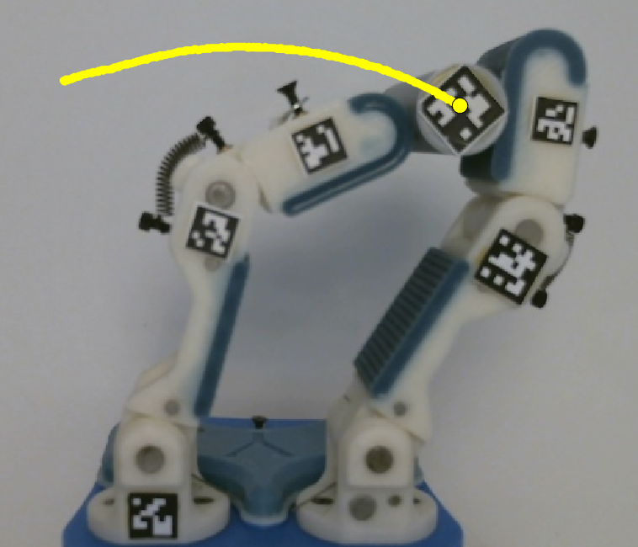
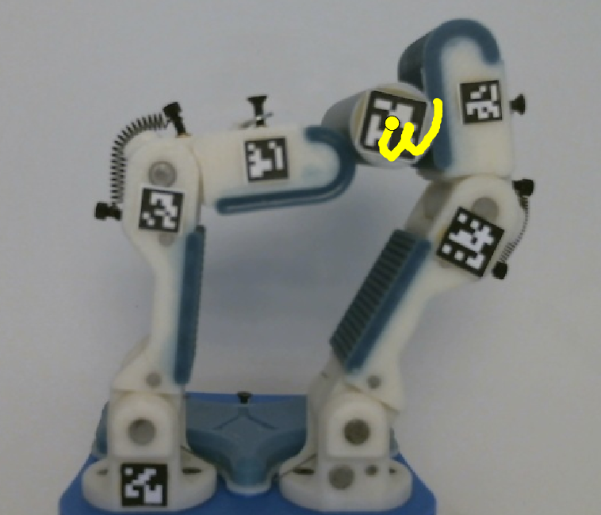
Adaptive hands
Precise Manipulation Primitives proposed by Calli and Dollar approximates the kinematics of the hand and enables closed-loop visual servoing manipulations.
However, when applying these primitives, the object tends to move in non-linear arc-like trajectories.
Therefore, tracking a path can be challanging and motion planning cannot be applied.

Slide 5
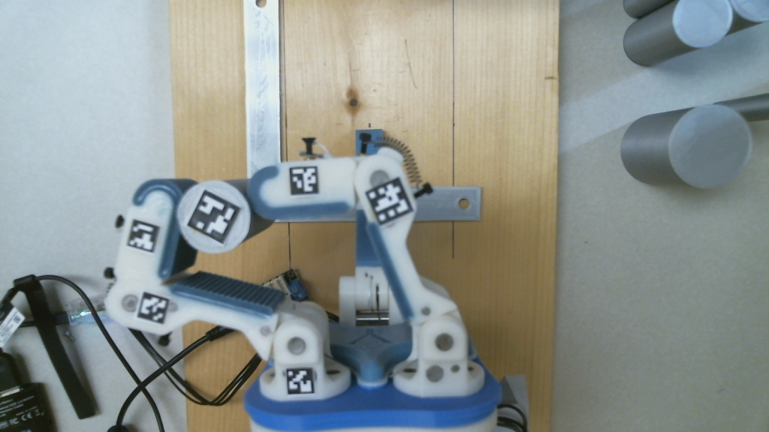
Transition model
Our paper deals with learning of a transition model of an adaptive hand that would enable accurate predictions for motion planning, closed-loop control and policy-search algorithms.

Slide 6
Transition model
In our work we focus on three questions:
What are the dominant features (e.g., object and links positions, actuators angles and torques) of an adaptive hand that are sufficient in describing its state and can provide accurate predictions?
Can a trained model based on these features and on transition data of a set of objects generalize to provide accurate predictions for the manipulation of an unknown object?
When using local regression with Gaussian Process, what is the appropriate metric for choosing nearest neighbors in the proximity of the query state-action pair?

Slide 7
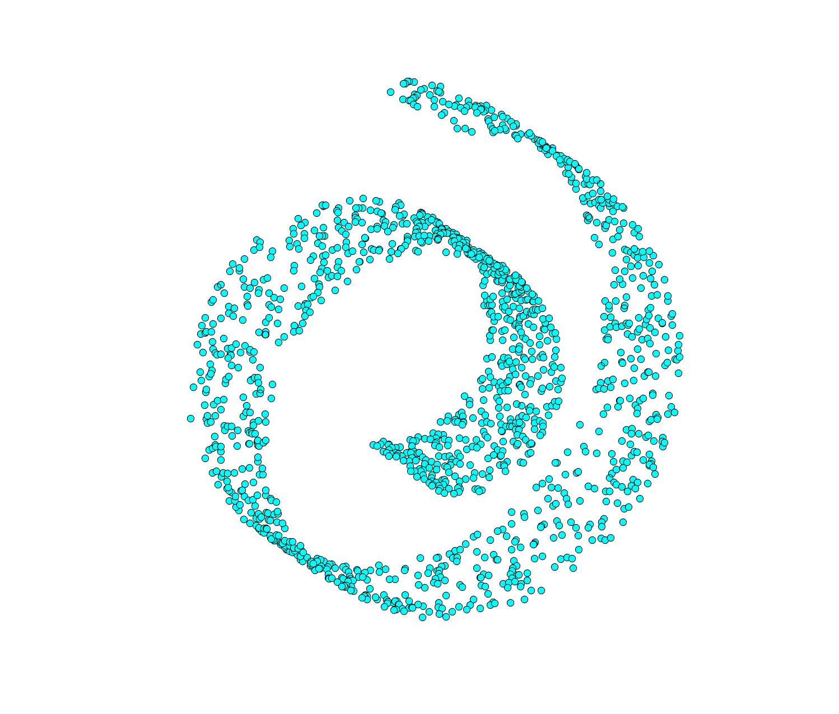
Manifold learning
We propose the Manifold Learning based Gaussian Process (MLGP) to select nearest neighbors based on the actual distance along the manifold, i.e., geodesic distance.
By utilizing diffusion maps, a known manifold learning technique, we can uncover the lower-dimensional subspace in which the data lies.
We choose the nearest neighbors for regression only in the lower dimensional space.
MLGP provides significant runtime improvement compared to simple Euclidean-based Gaussian Process (EGP).

Slide 8
Results of EGP (100) compared to MLGP for three trajectories and a 20 mm cylinder

Slide 9
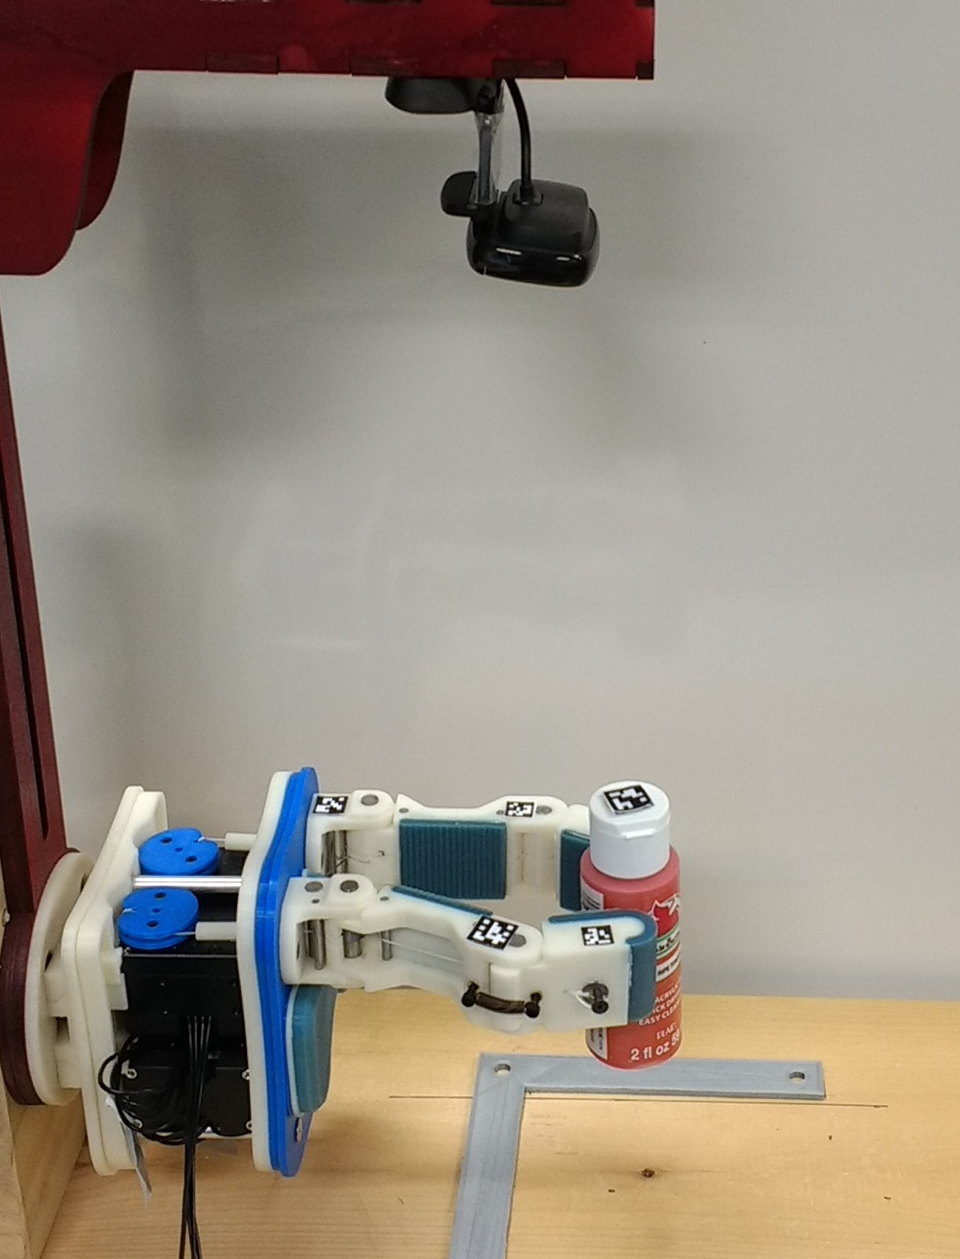
Feature configurations
We compare 7 feature configurations to represent the state space:
Object position (2 dim.).
Object position and distal links position (6 dim.).
Object position and all links positions (10 dim.).
Object position and actuators angles (4 dim.).
Object position and actuators loads (4 dim.).
Object position and, actuators angles and loads (6 dim.).
All measured features (14 dim.).
Gripper links
positions
Actuators angles
and loads
Object position

Slide 10
Feature configurations
We compare 7 feature configurations to represent the state space:
Object position (2 dim.).
Object position and distal links position (6 dim.).
Object position and all links positions (10 dim.).
Object position and actuators angles (4 dim.).
Object position and actuators loads (4 dim.).
Object position and, actuators angles and loads (6 dim.).
All measured features (14 dim.).
Gripper links
positions
Actuators angles
and loads
Object position
Results show that the objects position along with the actuators state (feature conf. 6) sufficiently embed the state of the system.

Slide 11
Closed loop control
We compare the use of a learned model to the model-free visual servoing proposed by Calli and Dollar.

